Slide 1
Science College, Kokrajhar
DEPARTMENT OF COMPUTER ENGINEERING
REAL TIME FACE RECOGNITION AUTOMATIC STUDENTS ATTENDENCE MANAGEMENT
Project Review By
Student Name1 and Roll
Student Name2 and Roll
Student Name3 and Roll
Student Name4 and Roll
Guided by By
guide name

Slide 2
INTRODUCTION
The purpose of the attendance monitoring system using face recognition is to ease the attendance process which consumes lot of time and efforts , it is a convenient and easy way for students and teacher. The system will capture the images of the students and using face recognition algorithm mark the attendance in the sheet. This way the class-teacher will get their attendance marked without actually spending time in traditional attendance marking

Slide 3
ABSTRACT
In the era of modern technologies emerging at rapid pace there is no reason why a crucial event in educational sector such as attendance should be done in the old boring traditional way. Attendance monitoring system will save a lot of time and energy for the both parties students as well as the class teachers. Attendance will be monitored by the face recognition algorithm by recognizing only the face of the students from the rest of the objects and then marking them as present. The system will be pre feed with the images of all the students and with the help of this pre feed data the algorithm will detect them who are present and match the features with the already saved images of them present in the database.

Slide 4
MOTIVATION
Nowadays many educational institutes are using a manual monitoring system and most of the time they accidentally loss their attendance sheet so that they cannot properly monitor the attendance of their students .Therefore it is important to design software which will help these institutes to mark the attendance of the students by face recognition which will save their time.

Slide 5
LITERATURE SURVEY
YEAR | AUTHOR | OBJECTIVES | METHODOLOGY | FINDINGS | PROBLEMS
2017 | Monica.C, Nithya.R, Prarthana.M, Sonika.S.V, Dr.M.Ramakrishna | Data of student has been computerized without using any manual effort. | The design is expressed in sufficient detail so as to enable all the developers to understand the underlying architecture of Attendance system. | The Existing system is a manual entry for the Admin and also Faculty. Here the attendance will be carried out in the hand written registers. Maintaining the records for the Faculty is a tedious job. | The requirements for the Software to work are much (Python, Tomcat, My SQL,) etc.

Slide 6
SURVEY NO.02
YEAR | AUTHOR | OBJECTIVES | METHODOLOGY | FINDINGS | PROBLEMS
2016 | Abdoulrahmaine Mohammad, Mohammad Elmi Hassan, Muslim Musa | Create a Window application to be used in place of old paper based user Employee Salary manage process | In this we study it capable of eliminating time wasted during manual collection of attendance and for the educational administration | The new system has been designed as per the user requirements so as to fulfill almost all them. -User friendly -Report Generation -Less paper work | Existing system requires lot of paper work. Loss of even a single register/record led to difficult situation because all the papers are needed to generate the reports.

Slide 7
REQUIREMENT
Minimum RAM: 256 MB
Hard Disk: 40 GB
Processor: Intel Pentium 4
Operating System: Windows OS, Linux OS, UNIX OS and Mac OS.

Slide 8
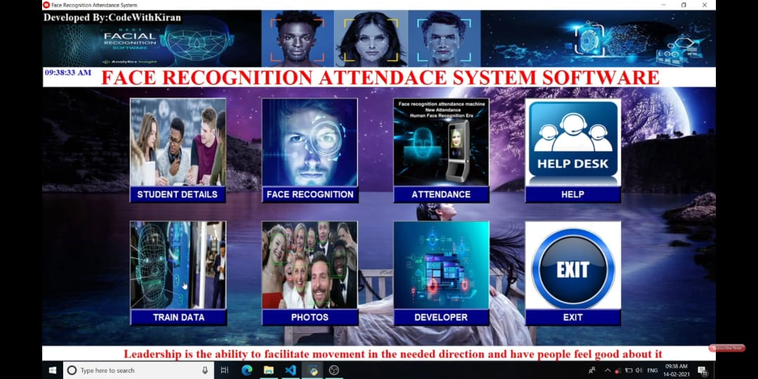
USER INTERFACE

Slide 9
FLOWCHART
Add students information and face in database
Database is trained in backend
Open the camera for recognition
Face recognition done
Attendance with date and time saved in database

Slide 10
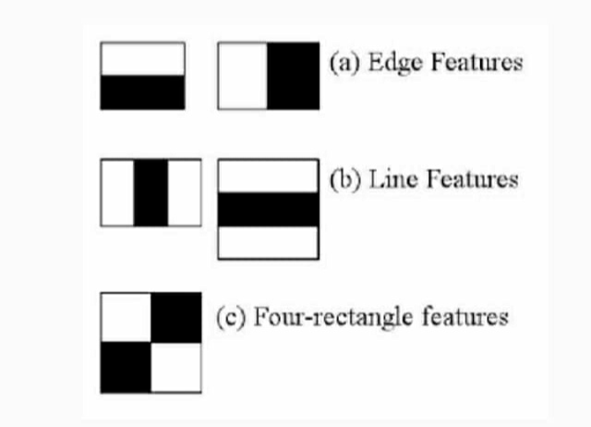
HAAR CASCADE ALGORITHM
It is an Object Detection Algorithm used to identify faces in an image or a real time
The algorithm is given a lot of positive images consisting of faces, and a lot of negative images not consisting of any face to train on them

Slide 11
LBPH ALGORITHM
The Local Binary Pattern Histogram(LBPH) algorithm is a simple solution on face recognition problem, which can recognize both front face and side face
Local Binary Pattern (LBP) is a simple yet very efficient texture operator which labels the pixels of an image by thresholding the neighbourhood of each pixel and considers the result as a binary number.

Slide 12
DETECTION AND RECOGNITION
Face Detection: It has the objective of finding the faces (location and size) in an image and probably extract them to be used by the face recognition algorithm.
Face Recognition: with the facial images already extracted, cropped, resized and usually converted to grayscale, the face recognition algorithm is responsible for finding characteristics which best describe the image.

Slide 13
VERIFIACATION
Verification or authentication of a facial image: it basically compares the input facial image with the facial image related to the user which is requiring the authentication. It is basically a 1x1 comparison.
Identification or facial recognition: it basically compares the input facial image with all facial images from a dataset with the aim to find the user that matches that face. It is basically a 1xN comparison.

Slide 14
LBPH was first described in 1994 (LBP) and has since been found to be a powerful feature for texture classification. It has further been determined that when LBP is combined with histograms of oriented gradients (HOG) descriptor, it improves the detection performance considerably on some datasets.
Using the LBP combined with histograms we can represent the face images with a simple data vector.

Slide 15
PARAMETERS OF LBPH
Radius: the radius is used to build the circular local binary pattern and represents the radius around the central pixel. It is usually set to 1.
Neighbors: the number of sample points to build the circular local binary pattern ,the more sample points we include, the higher the computational cost. It is usually set to 8.
Grid X: the number of cells in the horizontal direction. The more cells, the finer the grid, the higher the dimensionality of the resulting feature vector. It is usually set to 8.
Grid Y: the number of cells in the vertical direction. The more cells, the finer the grid, the higher the dimensionality of the resulting feature vector. It is usually set to 8.

Slide 16
TRAINING ALORITHM
Training the Algorithm: First, we need to train the algorithm. To do so, we need to use a dataset with the facial images of the people we want to recognize. We need to also set an ID (it may be a number or the name of the person) for each image, so the algorithm will use this information to recognize an input image and give you an output. Images of the same person must have the same ID.

Slide 17
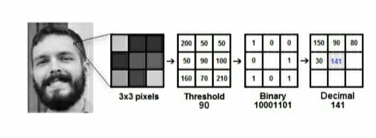
APPLYING LBP ALGORITHM
The first computational step of the LBPH is to create an intermediate image that describes the original image in a better way, by highlighting the facial characteristics. To do so, the algorithm uses a concept of a sliding window, based on the parameters radius and neighbors.

Slide 18
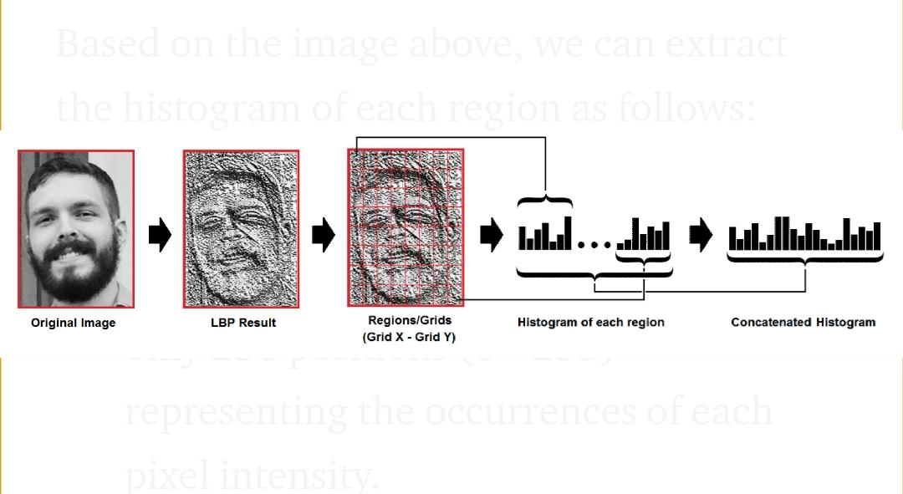
EXTRACTING HISTOGRSM
Now, using the image generated in the last step, we can use the Grid X and Grid Y parameters to divide the image into multiple grids, as can be seen in the following image:

Slide 19
PERFORMING THE FACE RECOGNITION
In this step, the algorithm is already trained. Each histogram created is used to represent each image from the training dataset. So, given an input image, we perform the steps again for new image and creates a histogram which represents the image.

Slide 20

ADVANTAGES
It is trouble-free to use.
It is a relatively fast approach to enter attendance
Is highly reliable, approximate result from user
Best user Interface

Slide 21
REFERANCES
G.Satyanarayana Reddy,Rallabandi Srinivasu,Srikanth Reddy Rikkula,Vuda Sreenivasa Rao,” Management Information System To Help Managers For Providing Decision Making In An Organization”, International Journal of Reviews in Computing.
G.Satyanarayana Reddy,Rallabandi Srinivasu,Srikanth Reddy Rikkula,Vuda Sreenivasa Rao,” Management Information System To Help Managers For Providing Decision Making In An Organization”, International Journal of Reviews in Computing.
Other websites;-
http://www.wordpress.org/
http://www.academia.edu/
http://www.stackoverflow.com/
http://www.iproject.com

Slide 22
CONCLUSION
The Attendance Management System is developed using Machine Learning meets the objectives of the system which it has been developed. The system has reached a steady state where all bugs have been eliminated. The system is operated at a high level of efficiency. The system solves the problem. It was intended to solve as requirement specification.

Slide 23
THANK YOU

